Slide 1
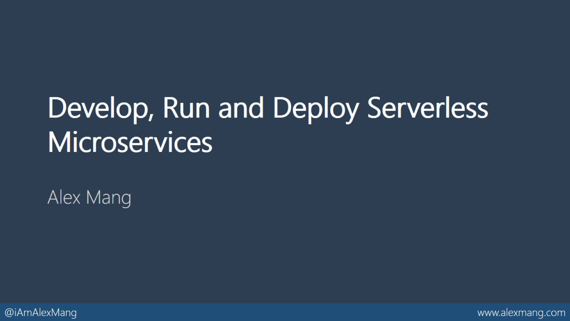
Develop, Run and Deploy Serverless Microservices

Slide 2
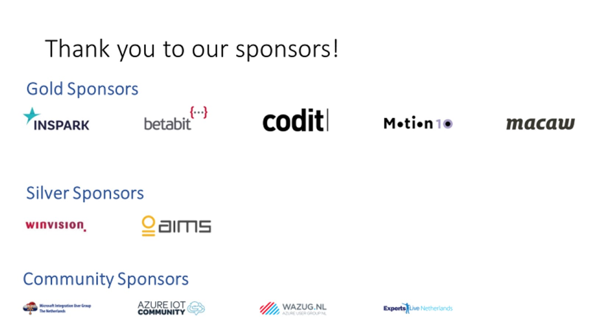

Slide 3
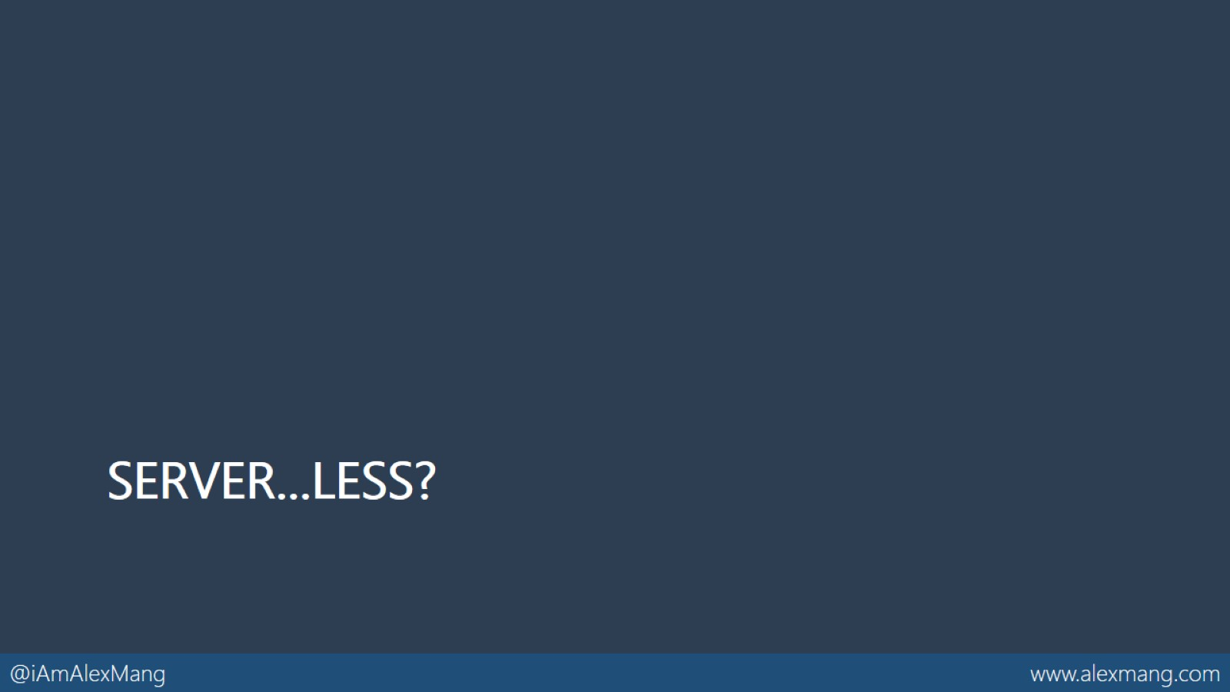
Server…less?

Slide 4
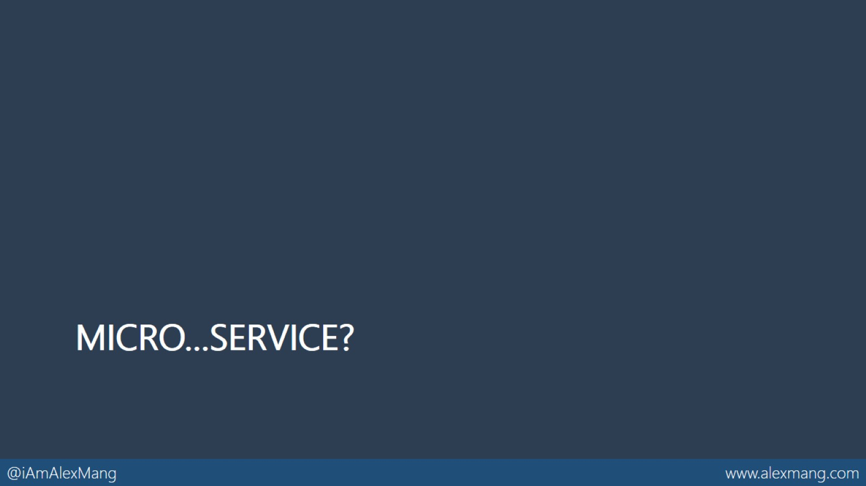
Micro…service?

Slide 5
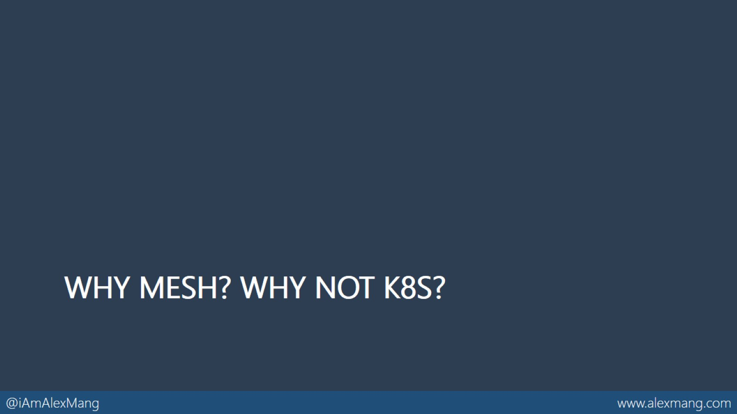
Why Mesh? Why not K8S?

Slide 6
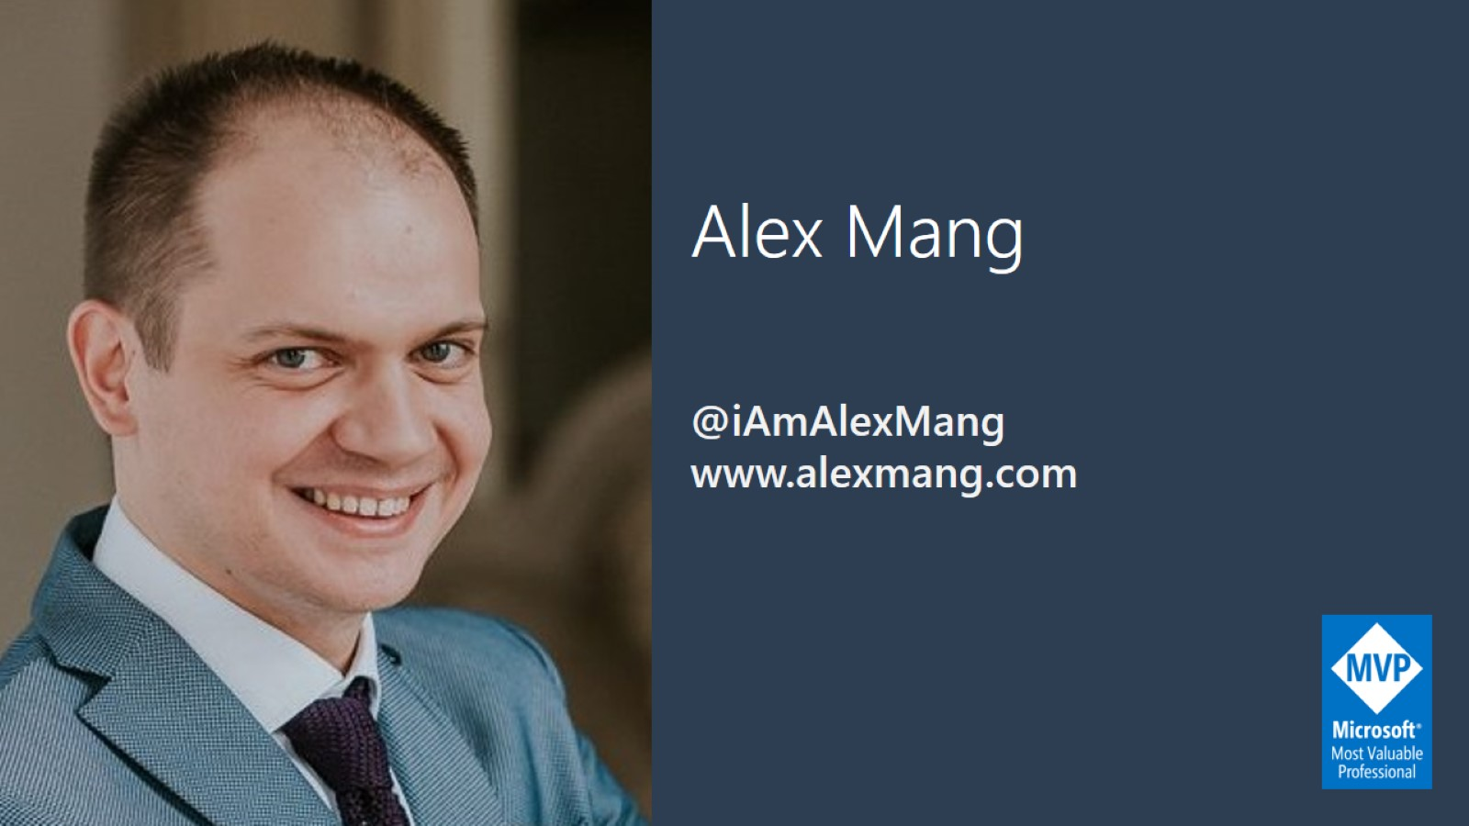
Alex Mang

Slide 7
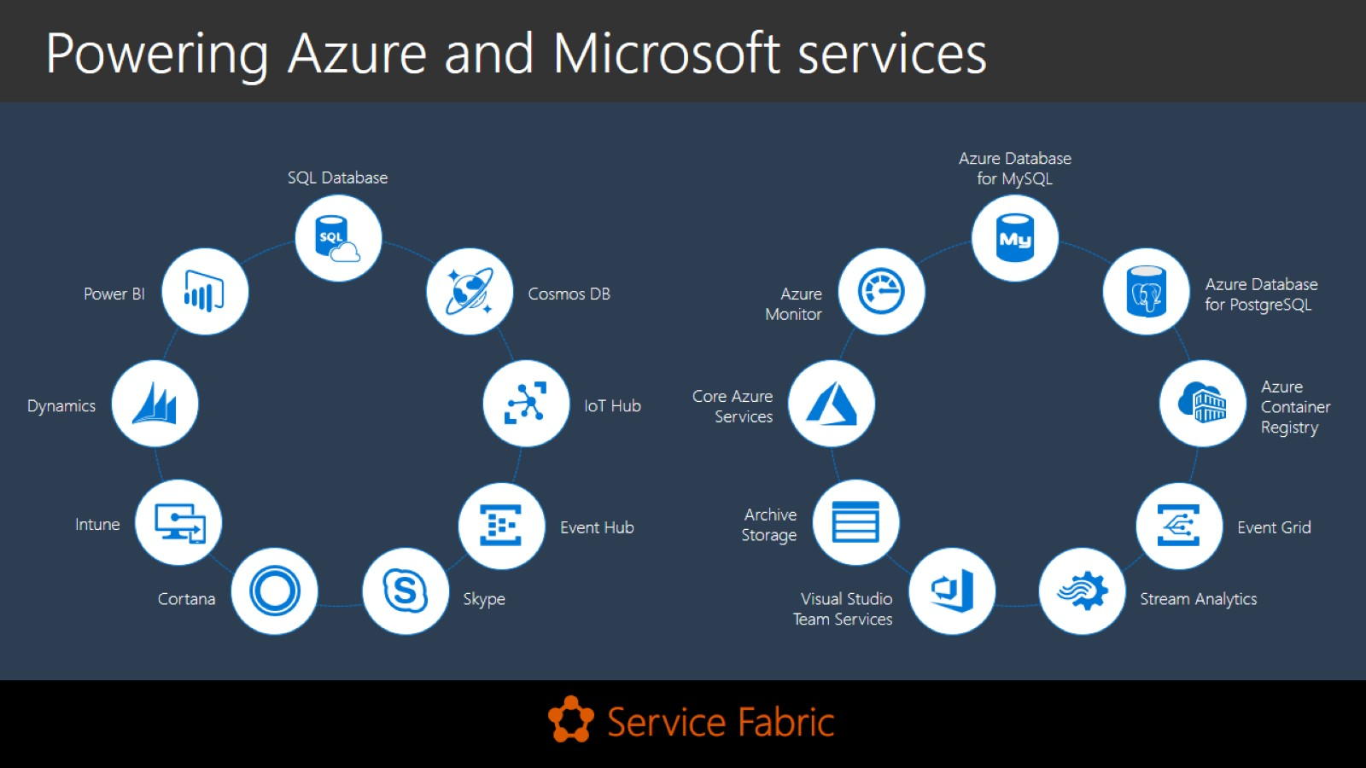
Powering Azure and Microsoft services

Slide 8
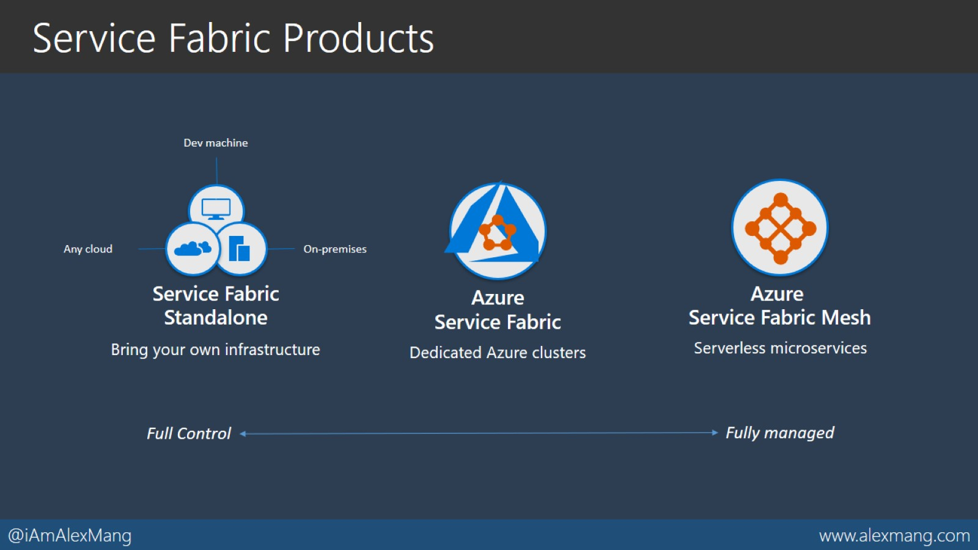
Service Fabric Products

Slide 9
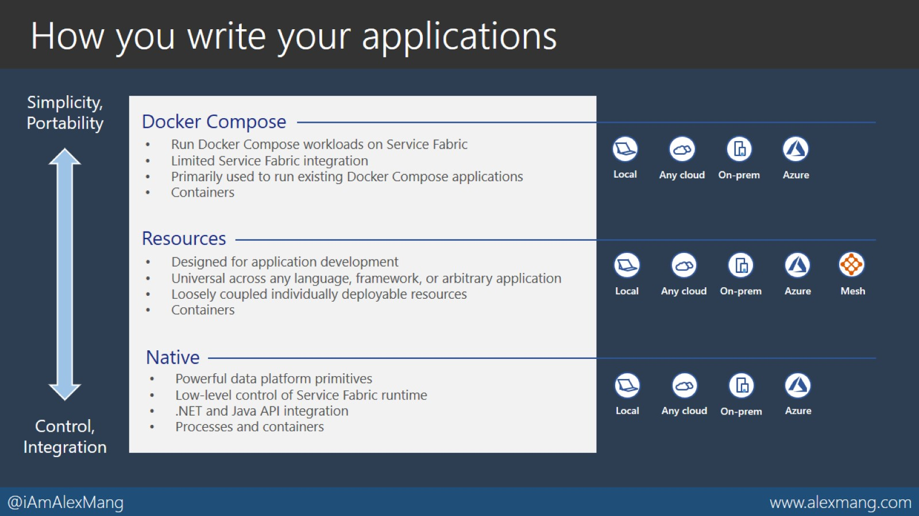
How you write your applications

Slide 10
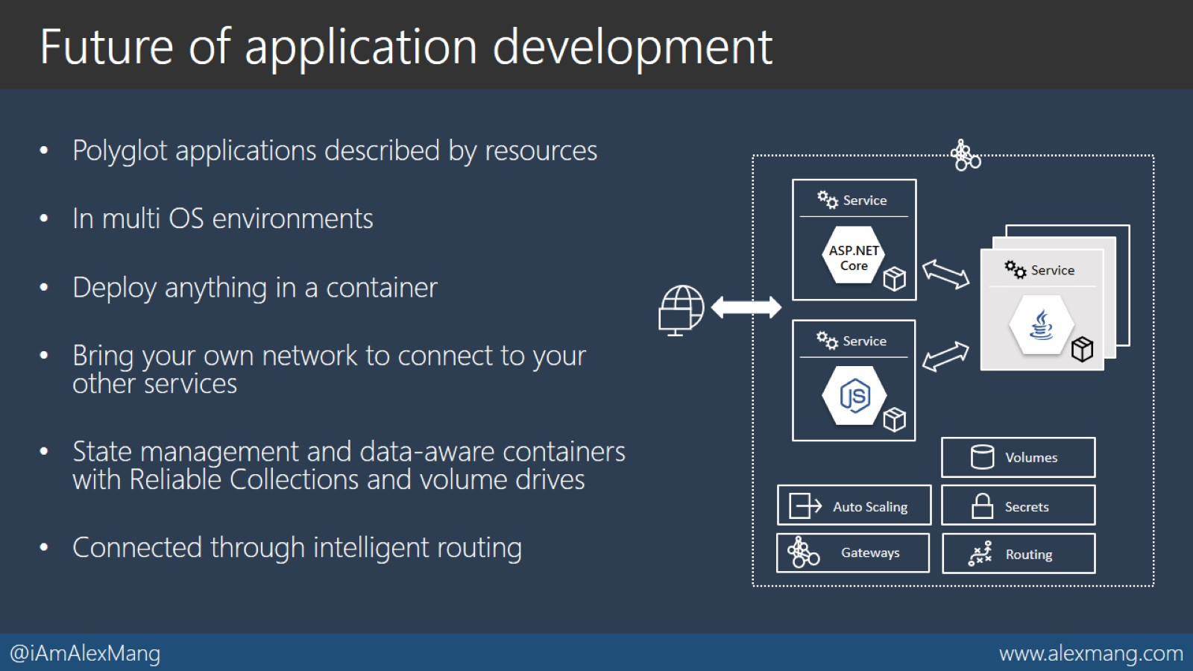
Future of application development

Slide 11
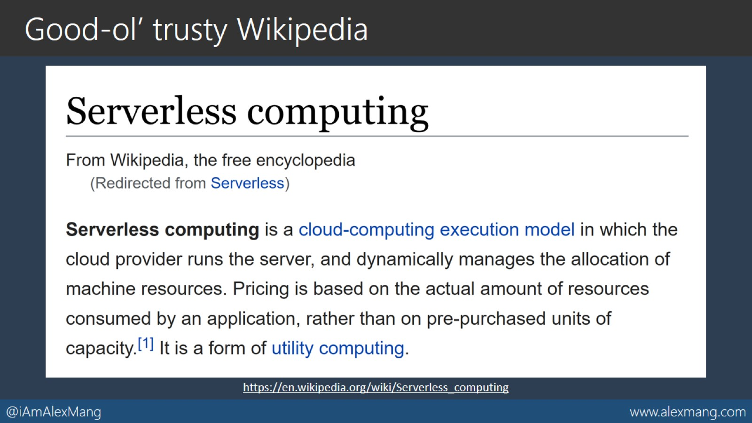
Good-ol’ trusty Wikipedia

Slide 12
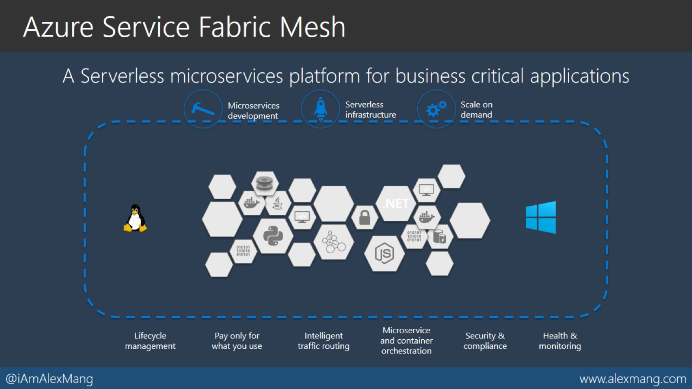
Azure Service Fabric Mesh

Slide 13
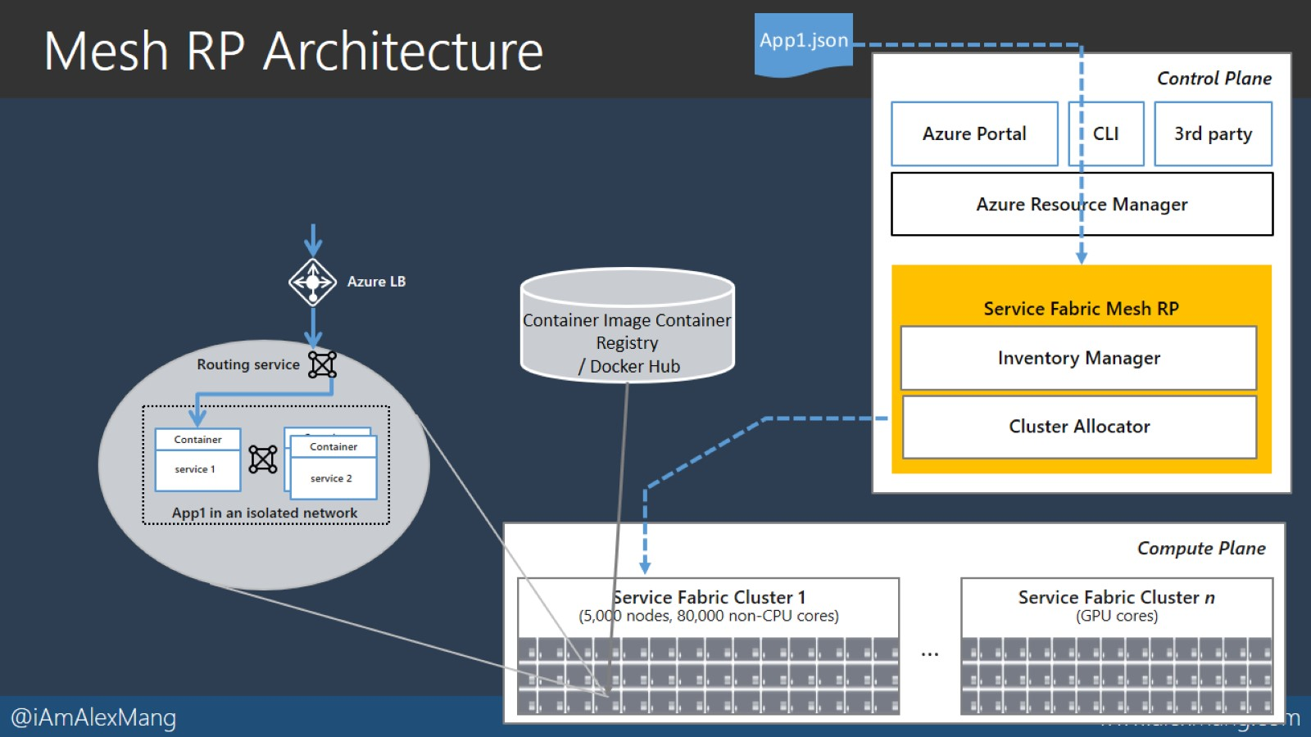
Mesh RP Architecture

Slide 14
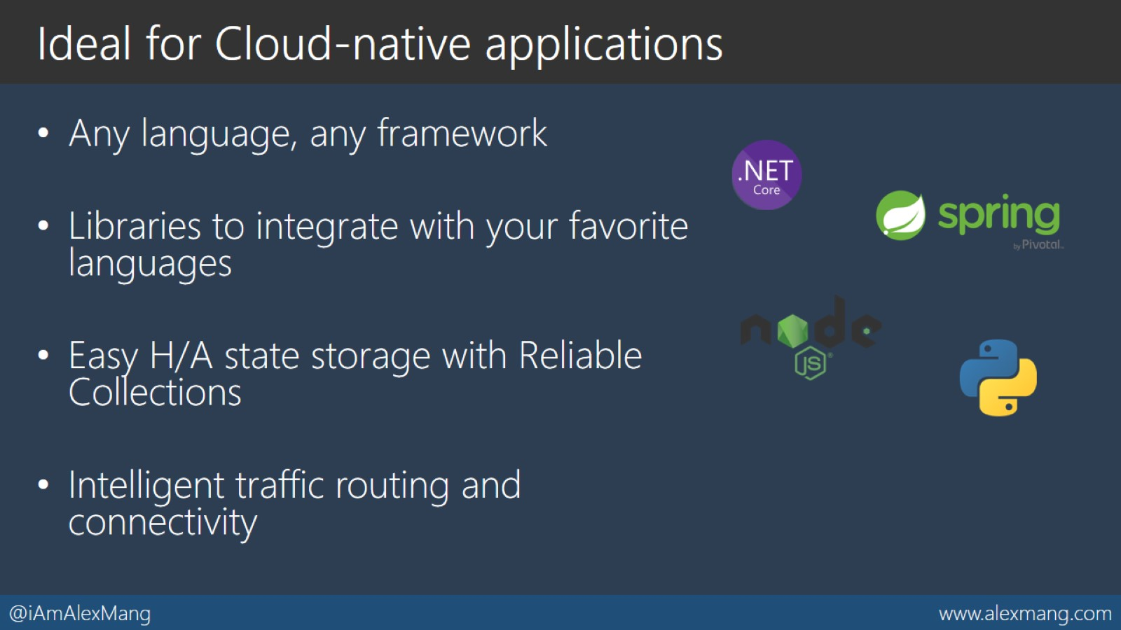
Ideal for Cloud-native applications

Slide 15
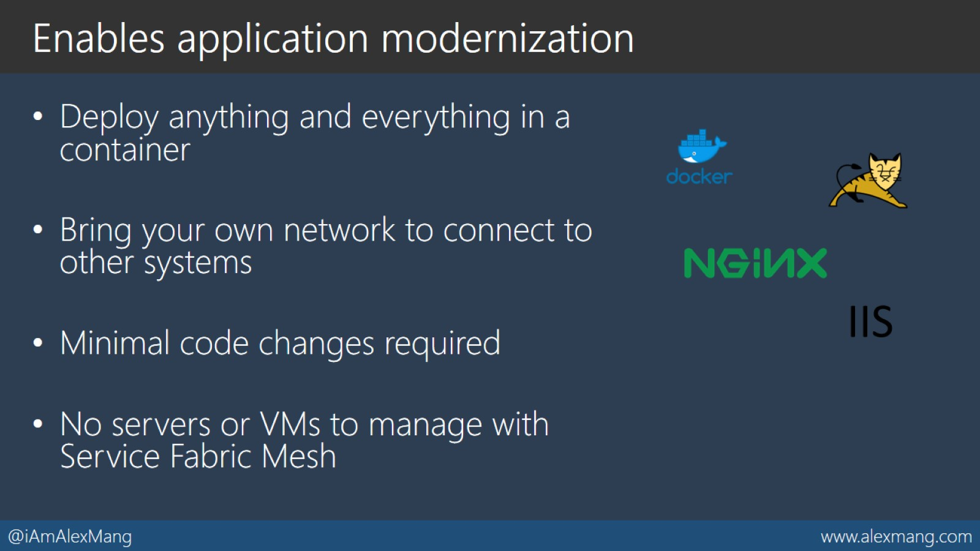
Enables application modernization

Slide 16
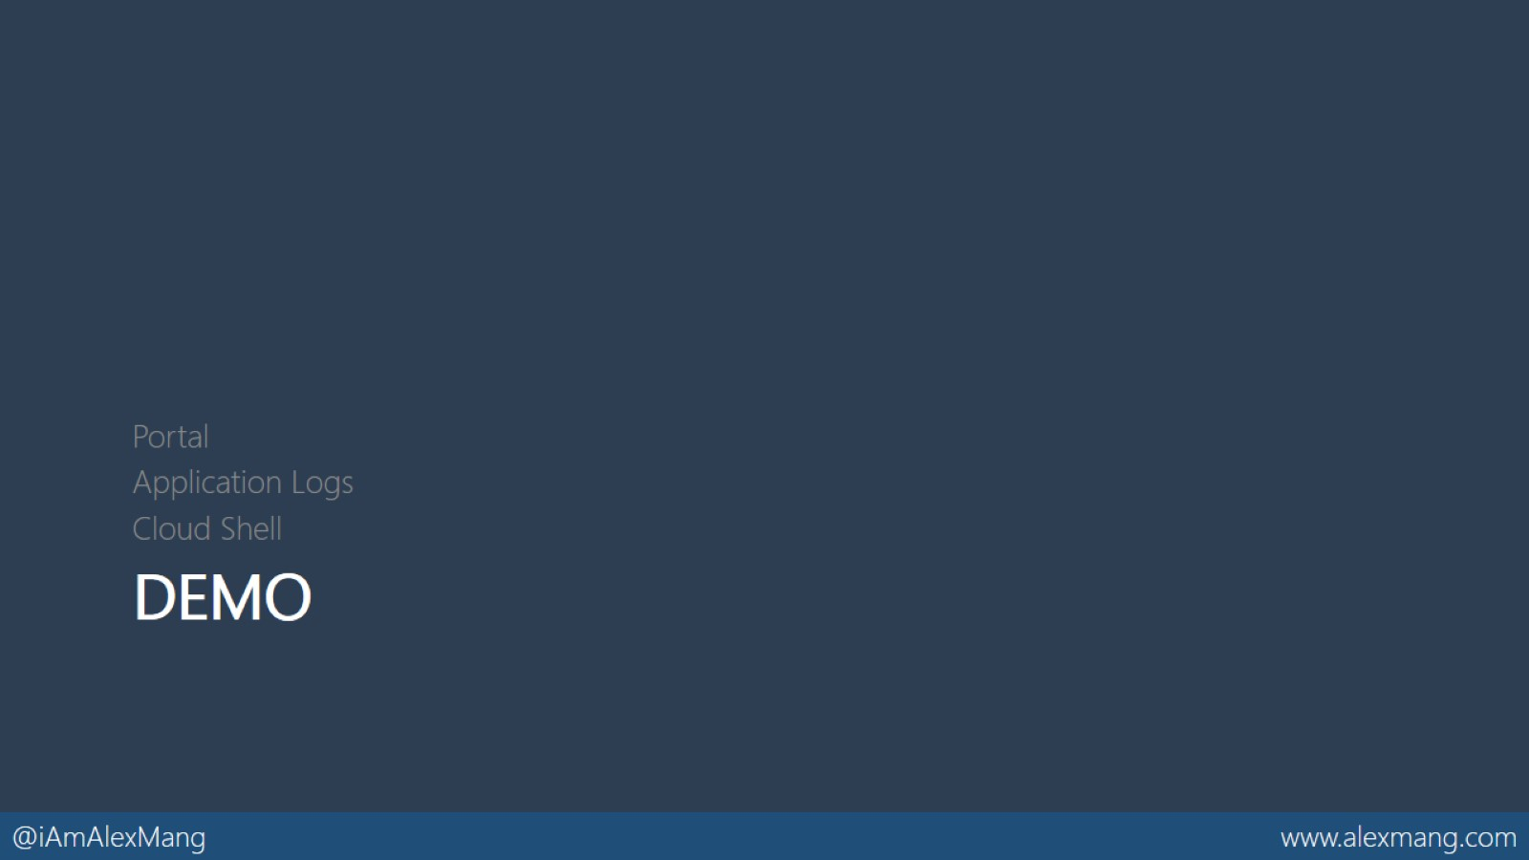
DEMO

Slide 17
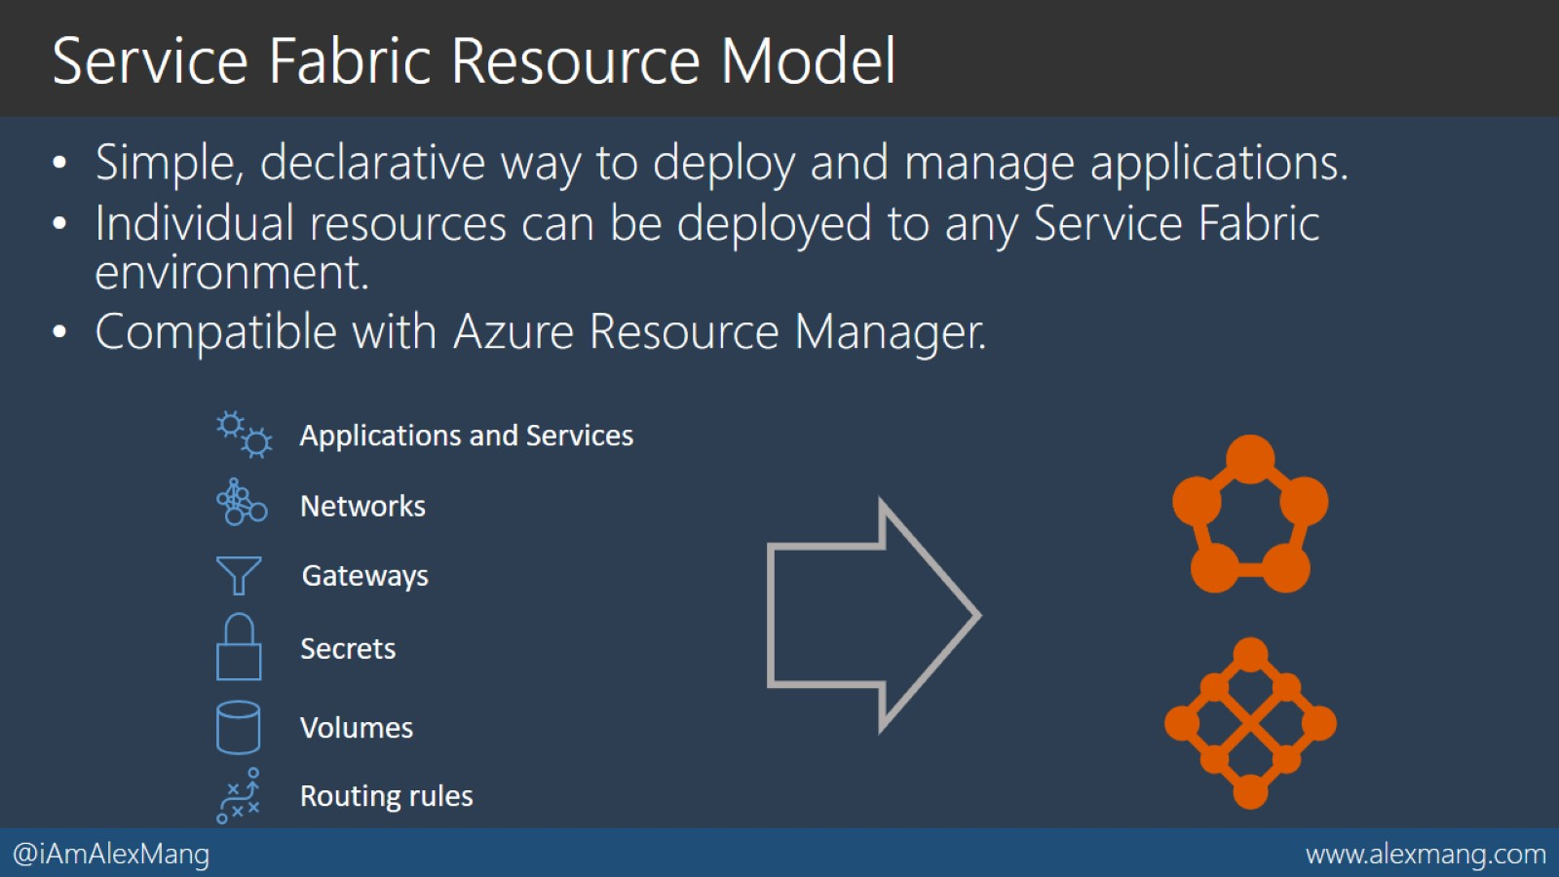
Service Fabric Resource Model

Slide 18
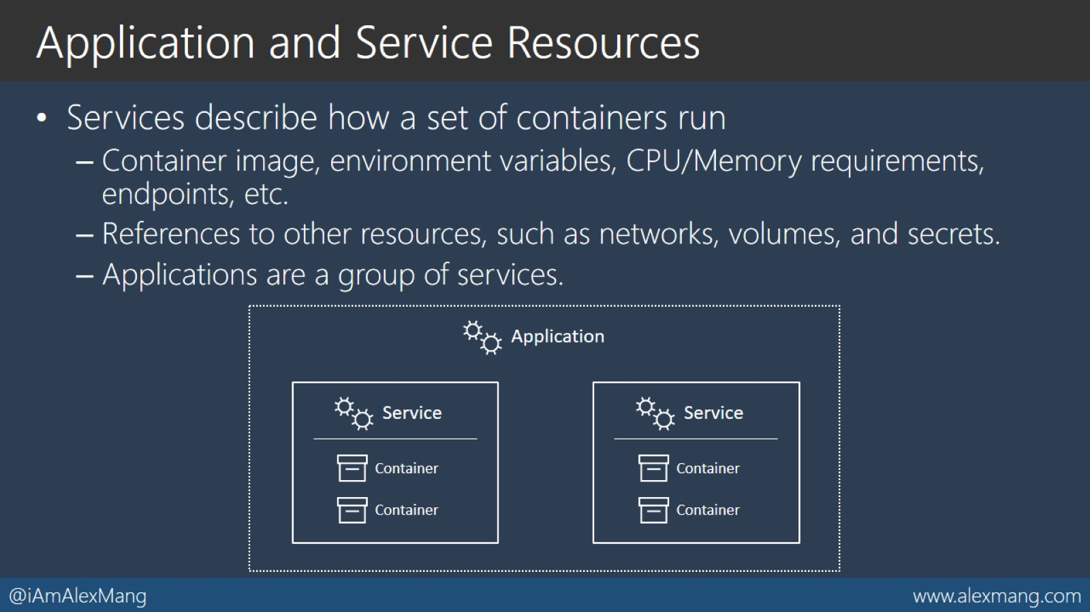
Application and Service Resources

Slide 19
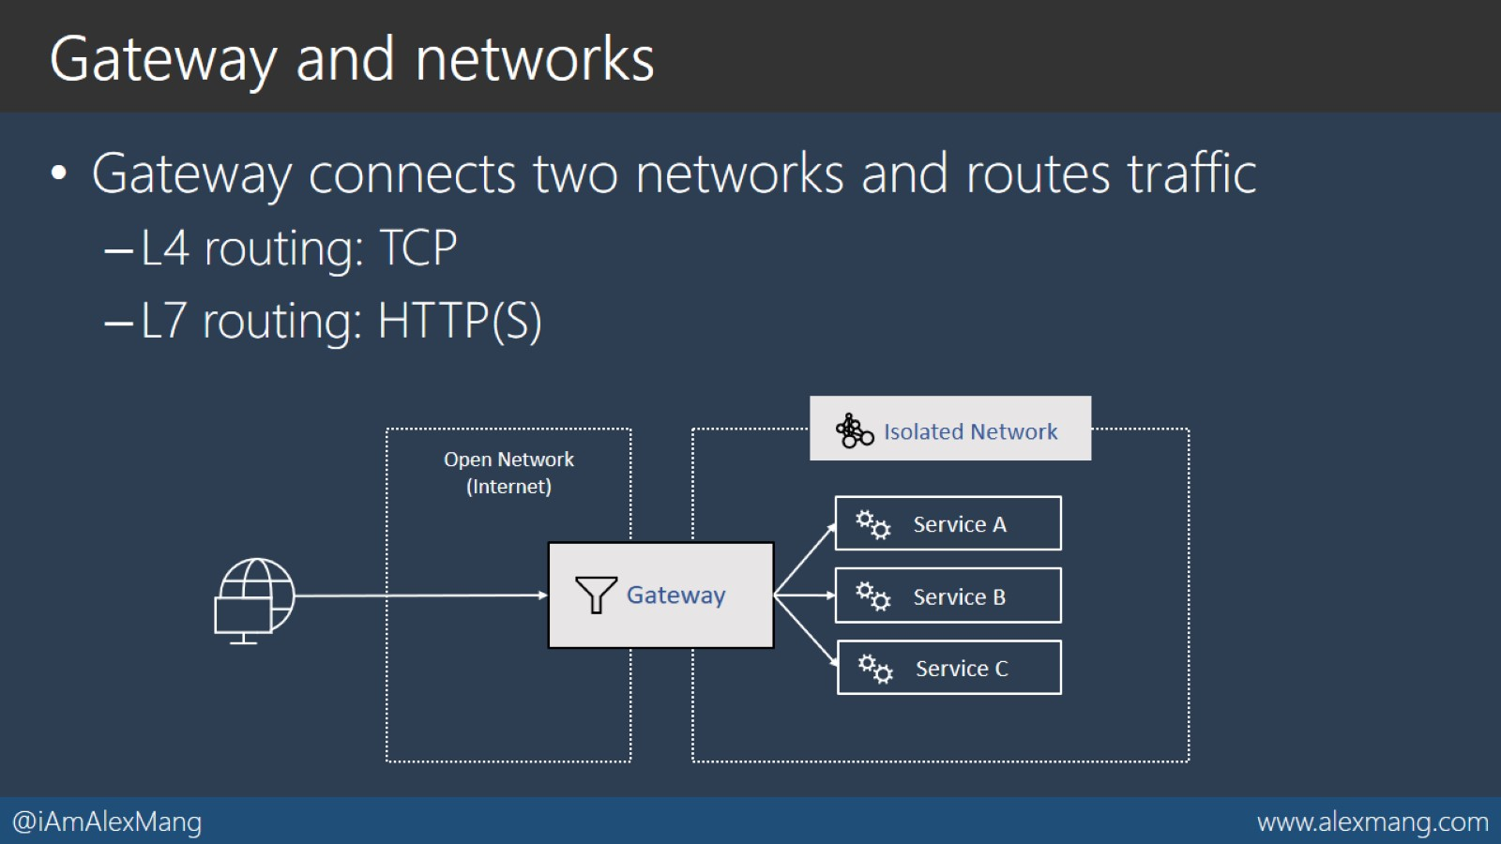
Gateway and networks

Slide 20
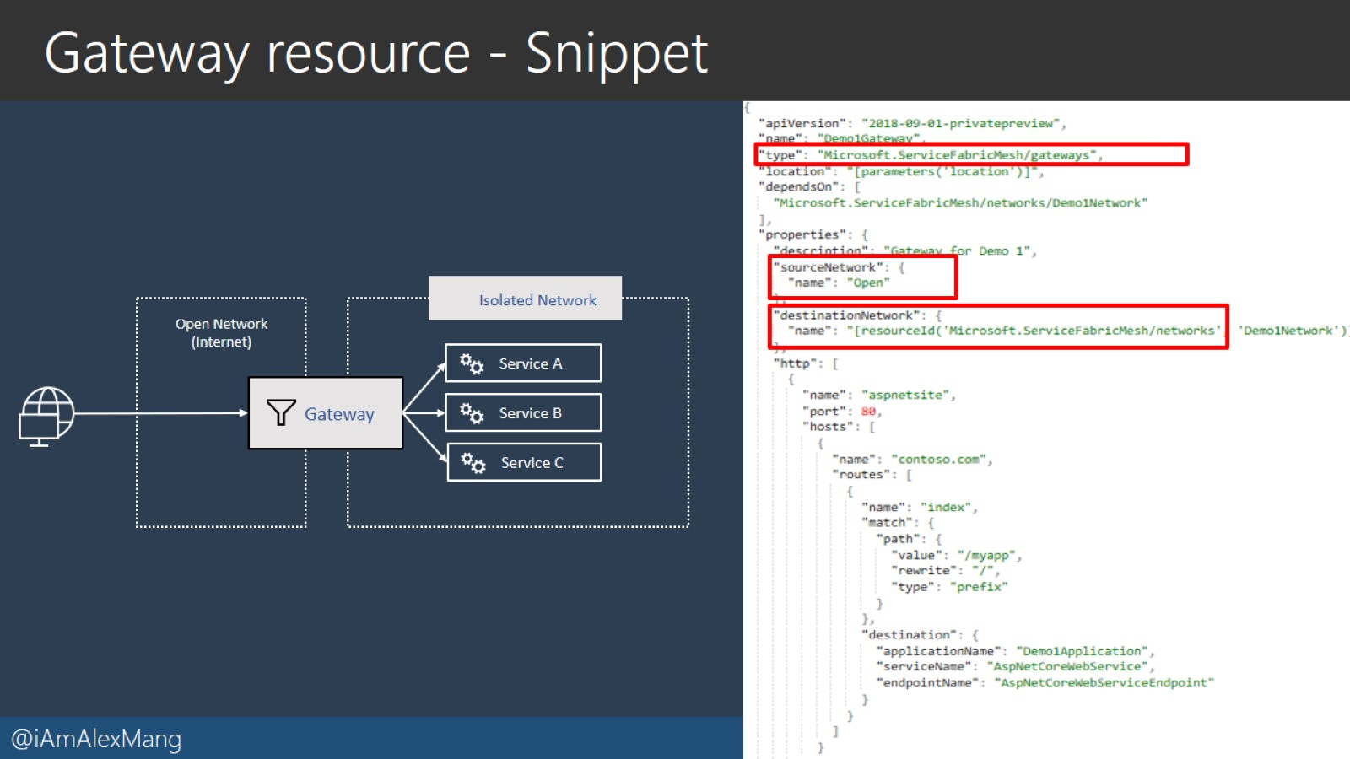
Gateway resource - Snippet

Slide 21
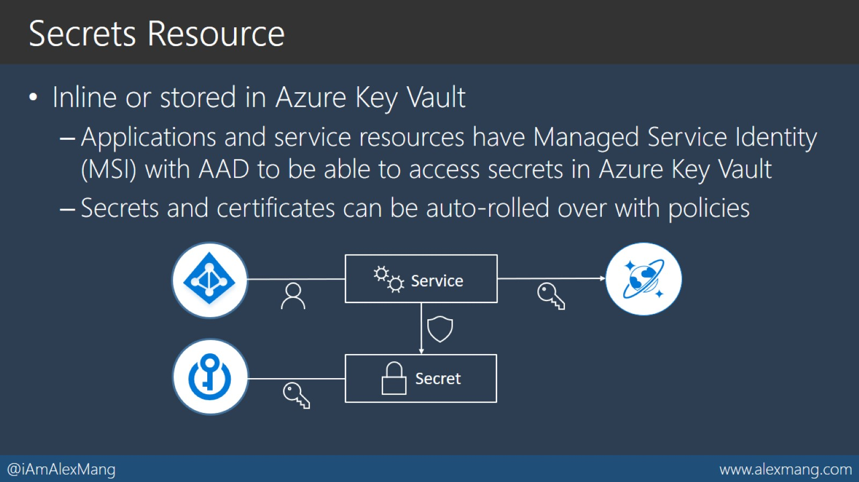
Secrets Resource

Slide 22
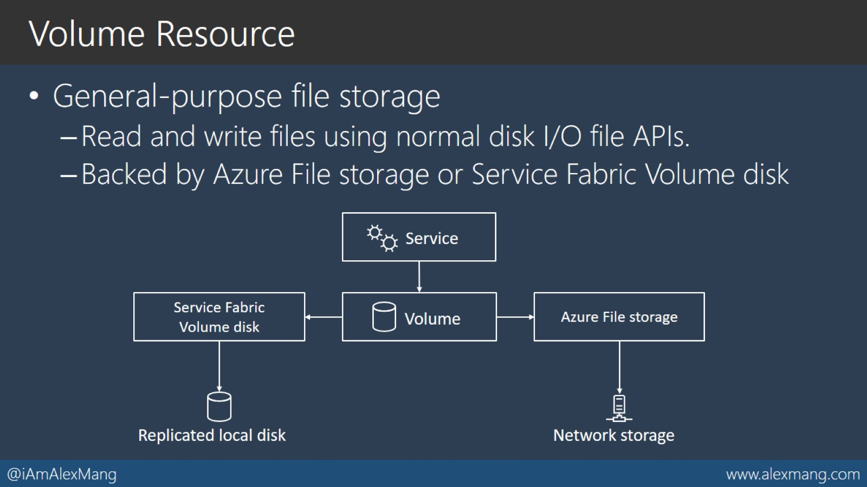
Volume Resource

Slide 23
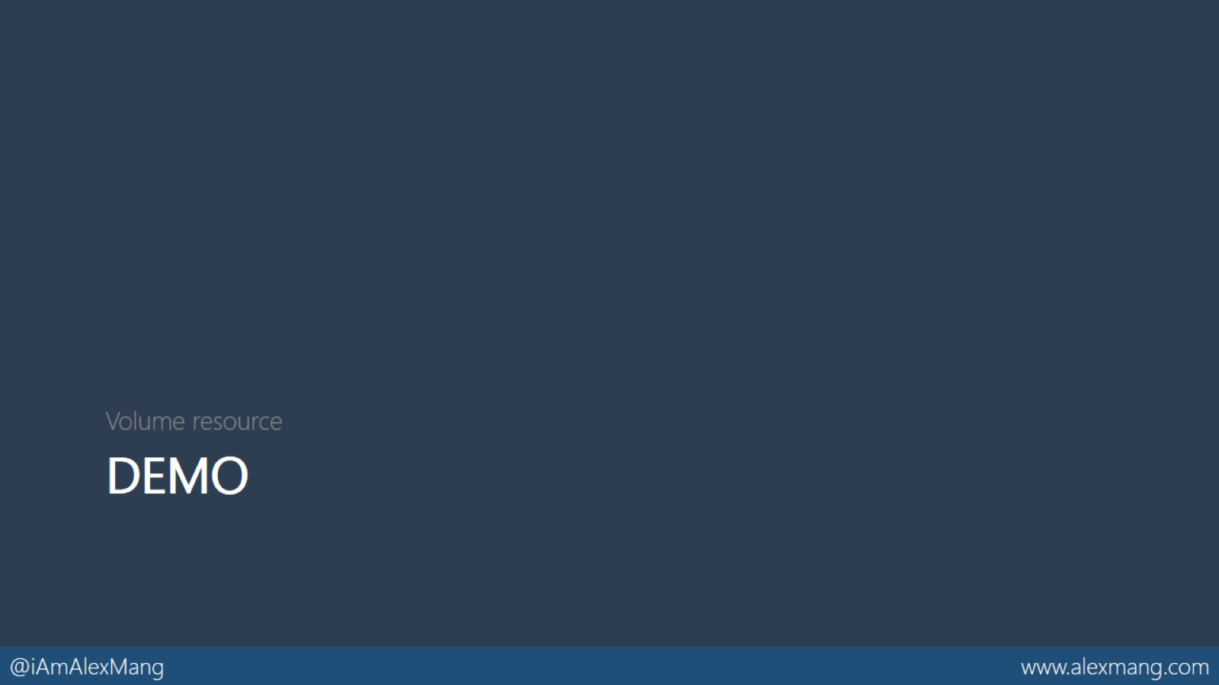
DEMO

Slide 24
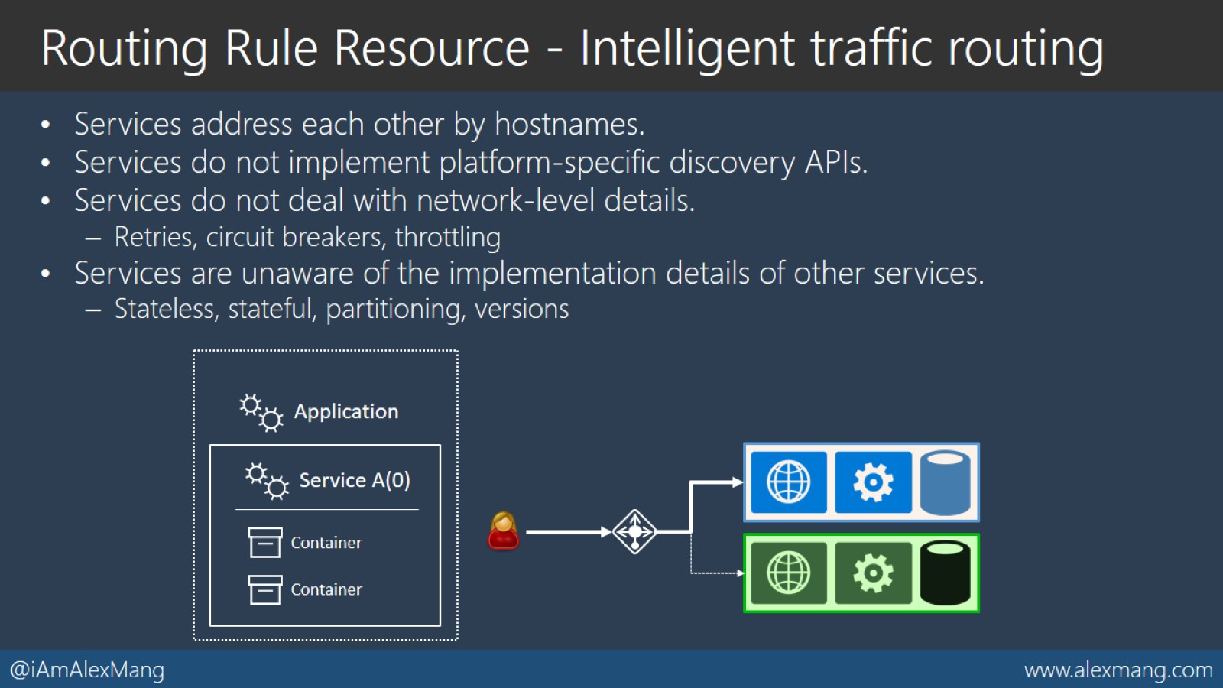
Routing Rule Resource - Intelligent traffic routing

Slide 25
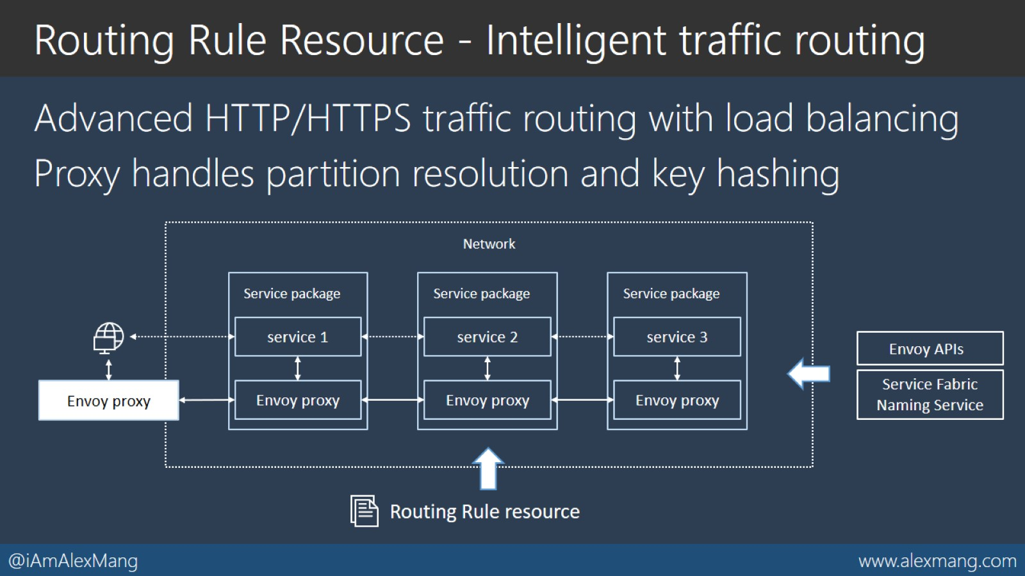
Routing Rule Resource - Intelligent traffic routing

Slide 26
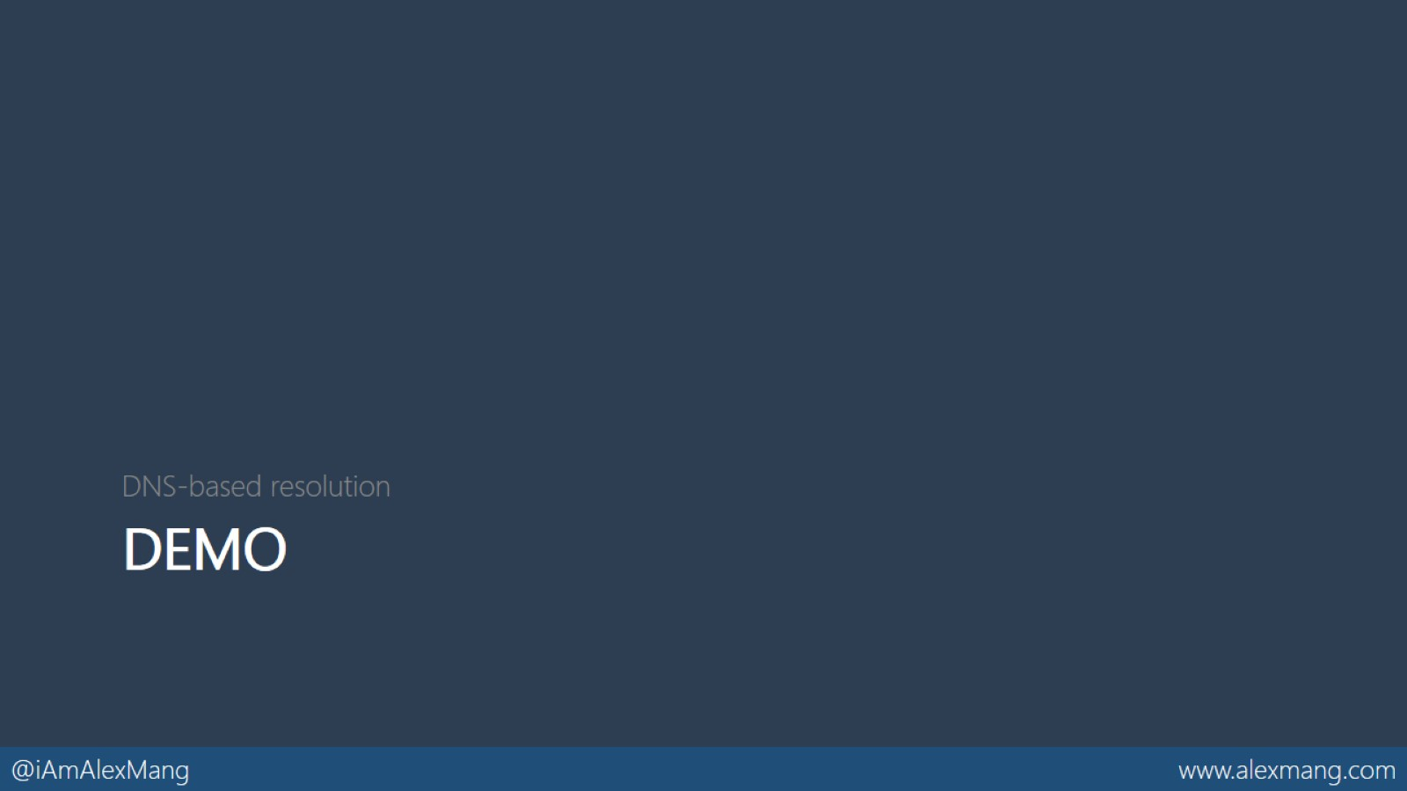
DEMO

Slide 27
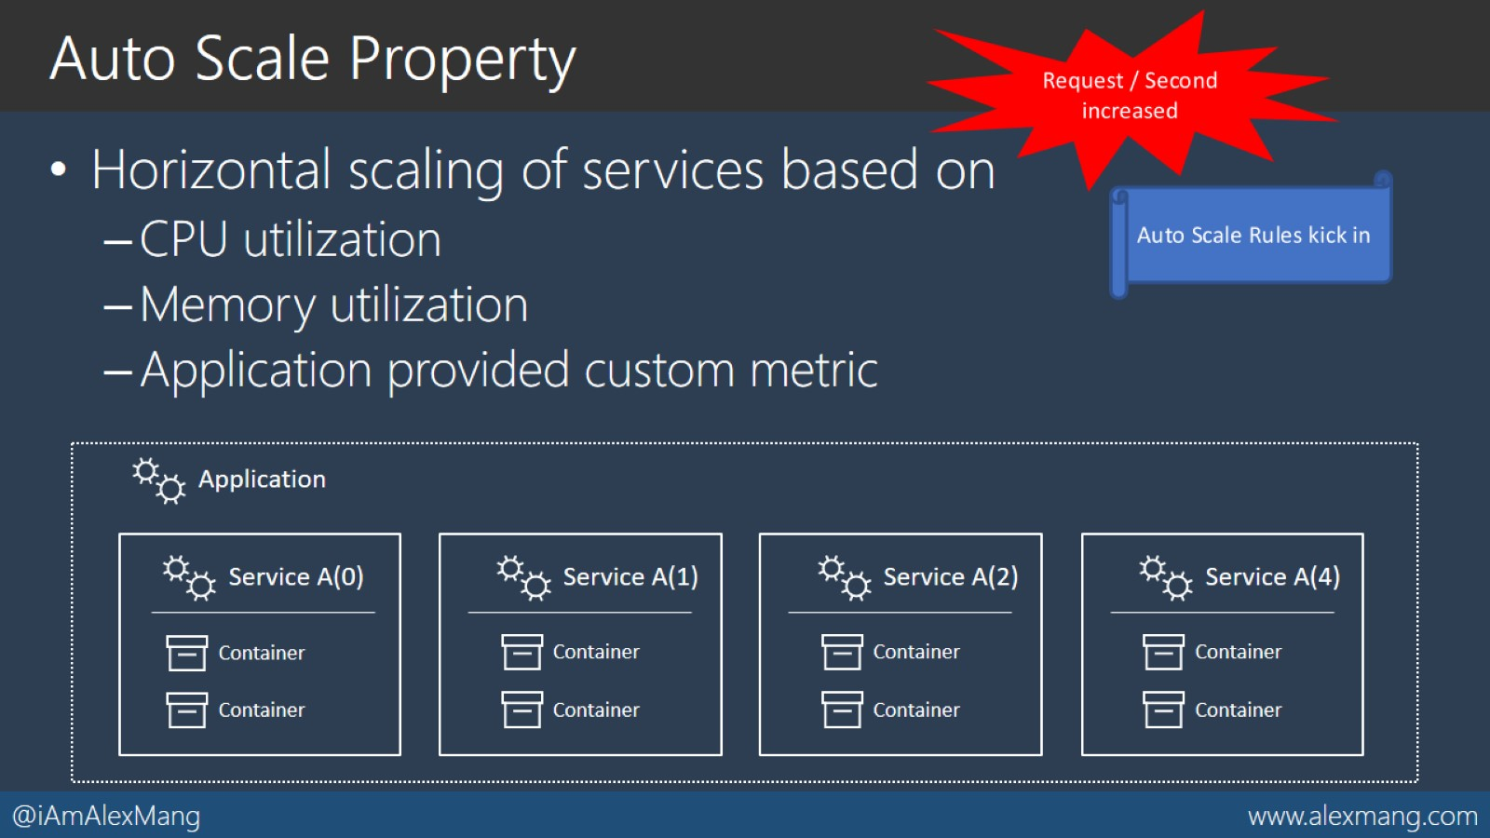
Auto Scale Property

Slide 28
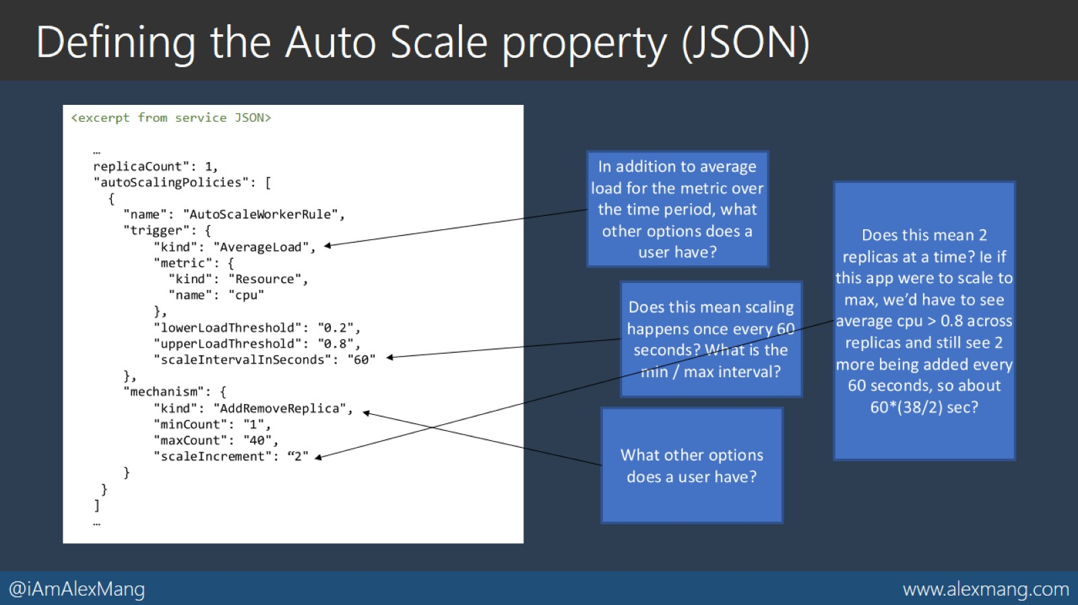
Defining the Auto Scale property (JSON)

Slide 29
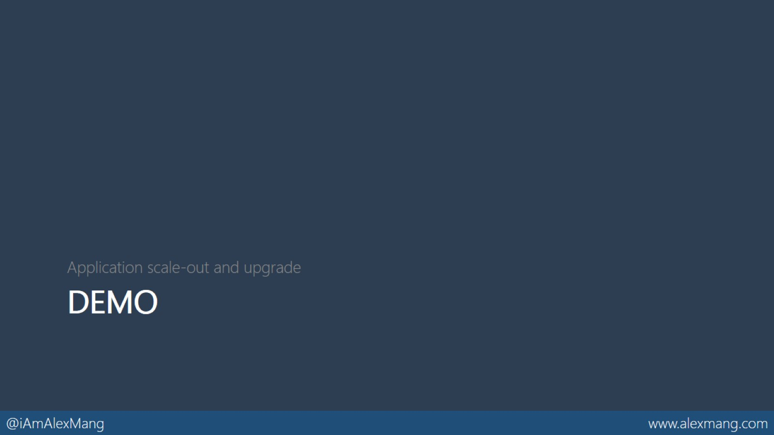
DEMO

Slide 30


Slide 31
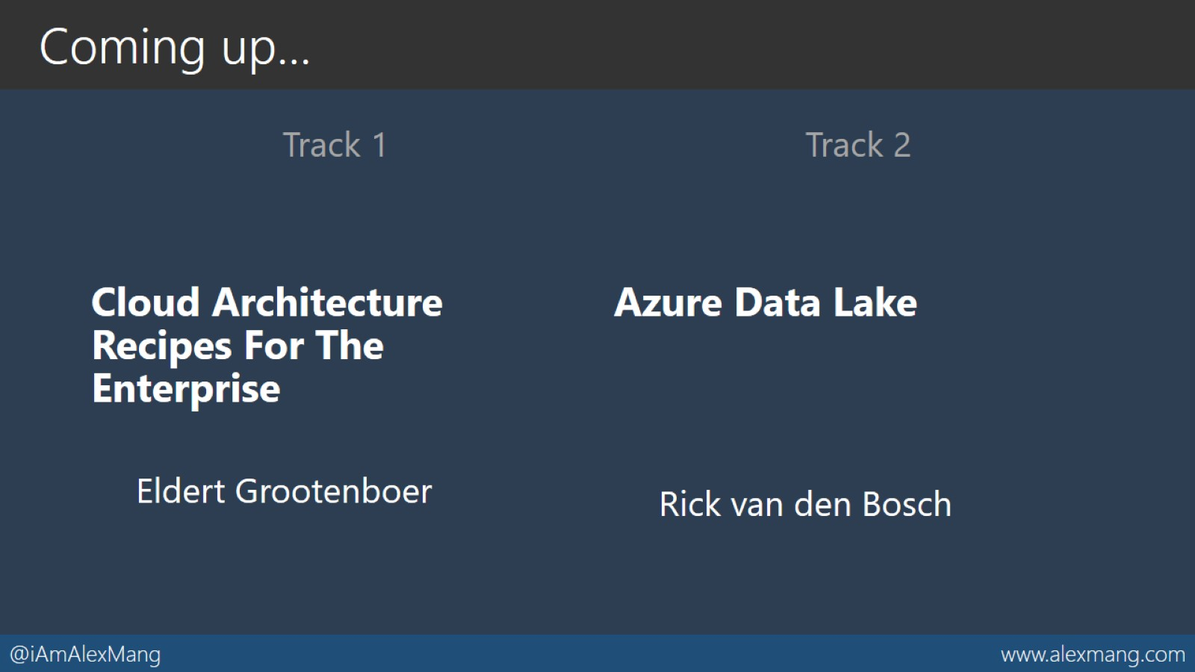
Coming up…

Slide 32

Thank You!

Slide 33
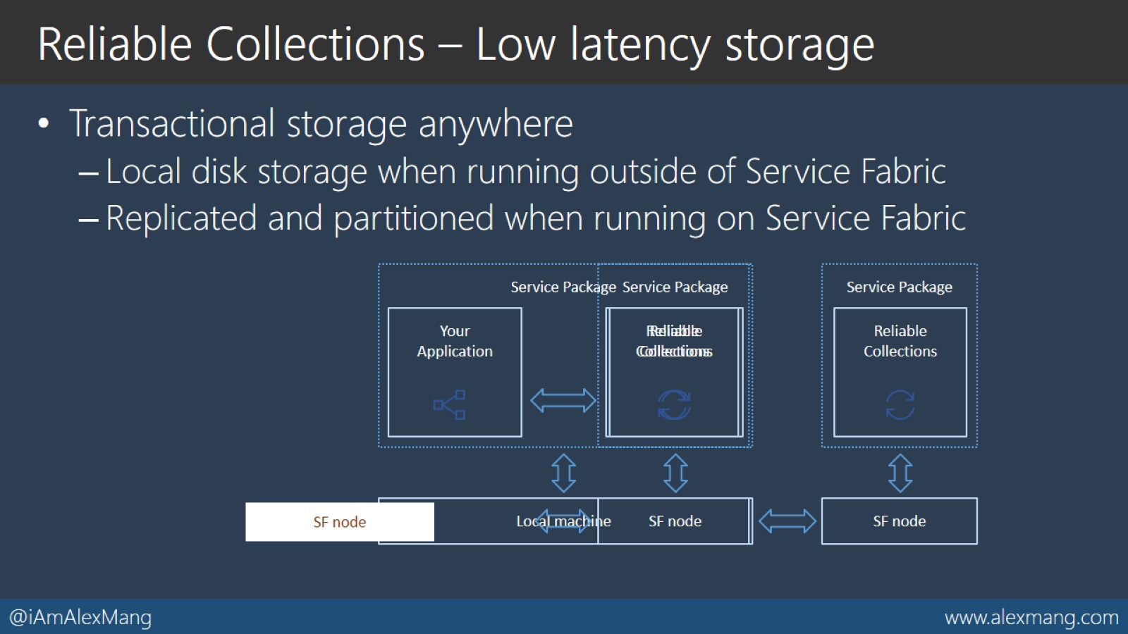
Reliable Collections – Low latency storage

Slide 34
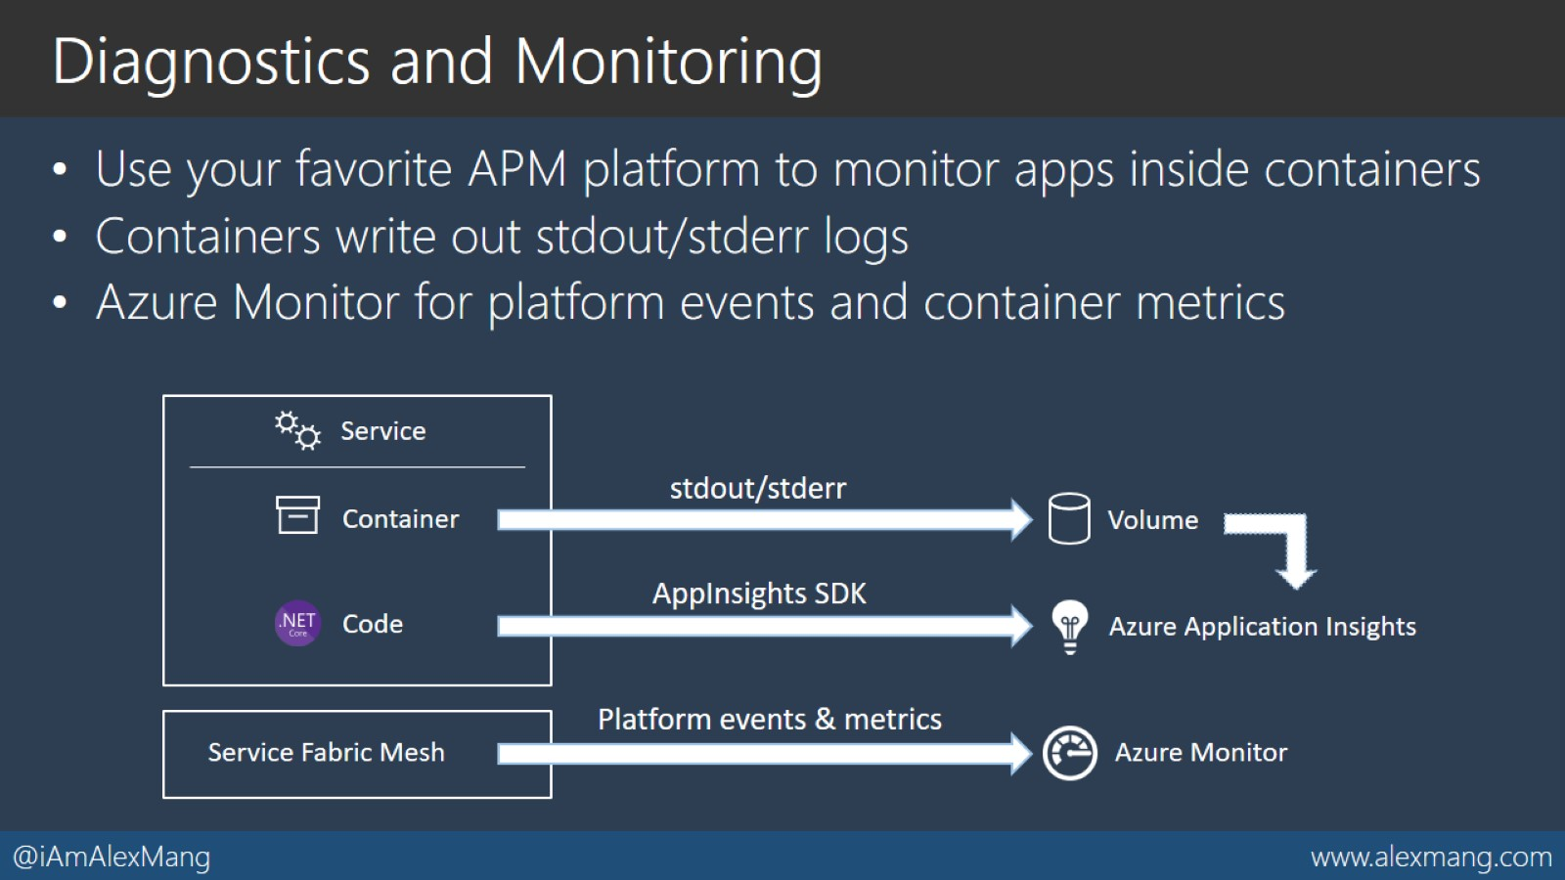
Diagnostics and Monitoring

Slide 35
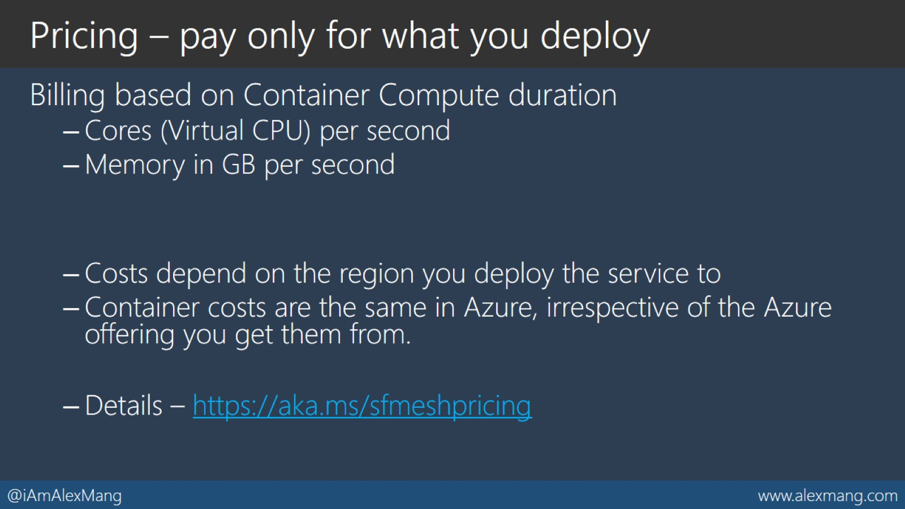
Pricing – pay only for what you deploy

Slide 36
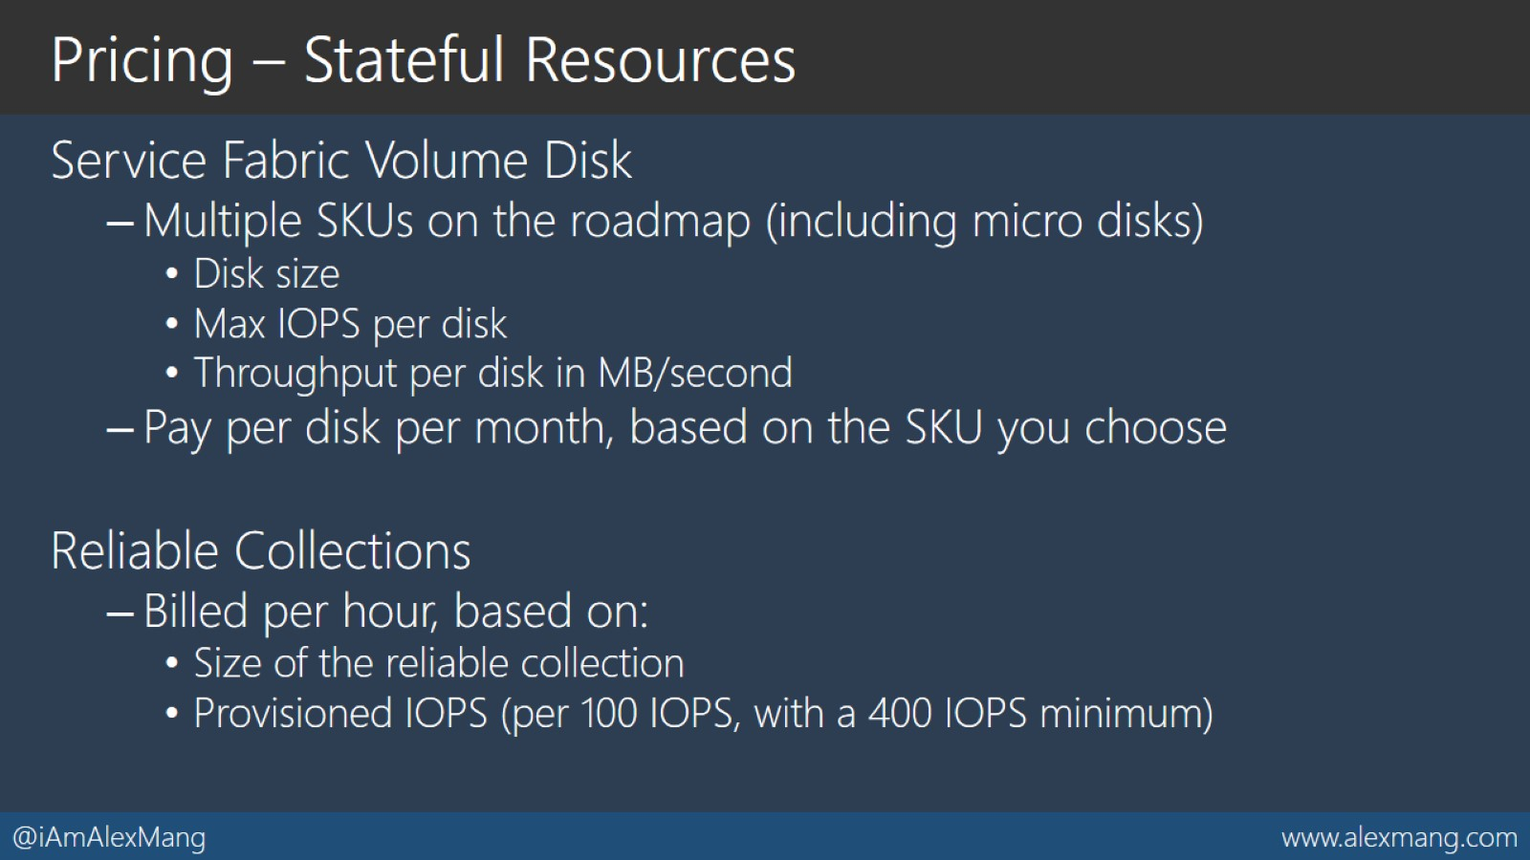
Pricing – Stateful Resources

